Slide 1
Continental Shelf Sedimentation

Slide 2
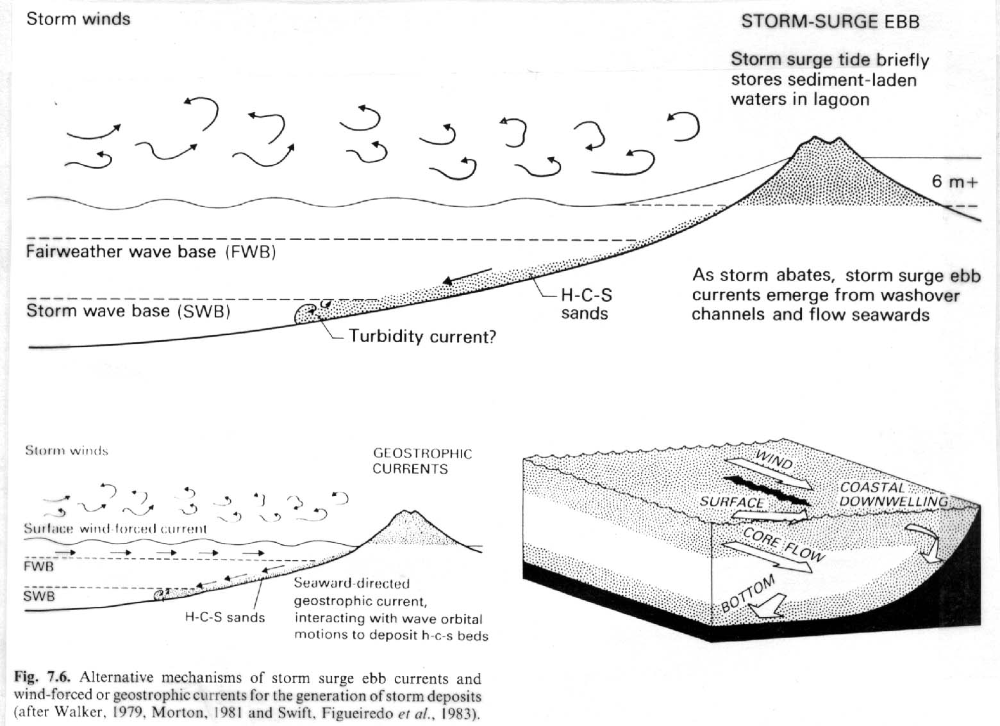
Storm surge and shelf sedimentation

Slide 3
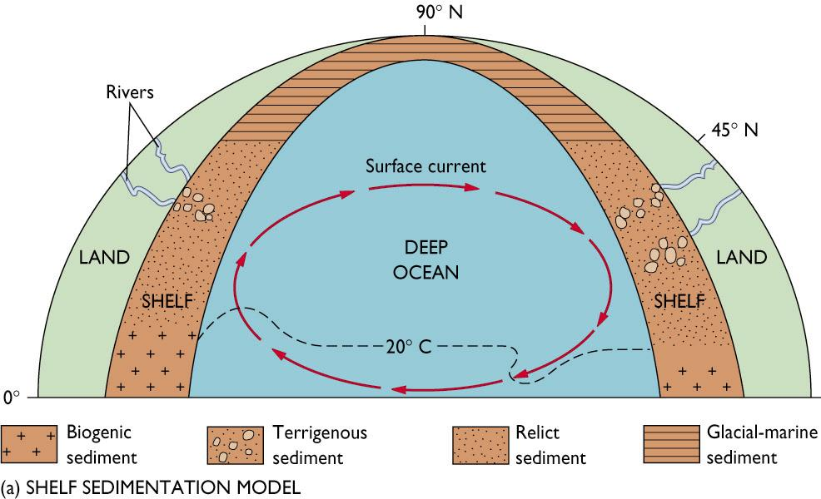

Slide 4
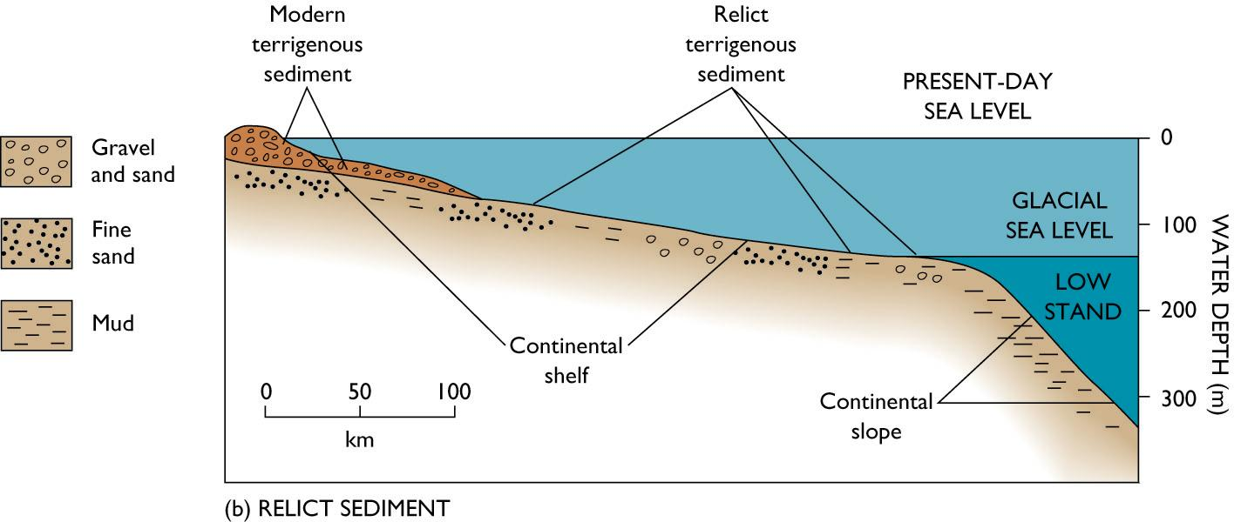

Slide 5
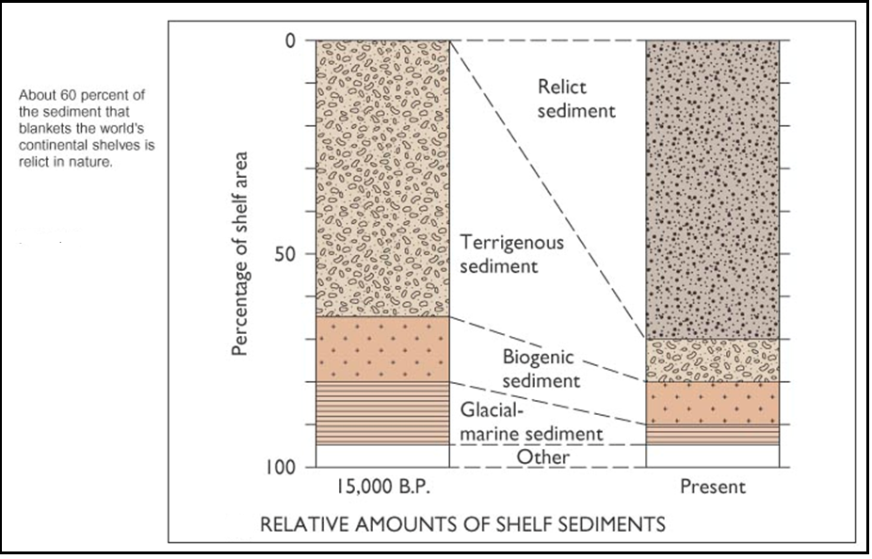

Slide 6
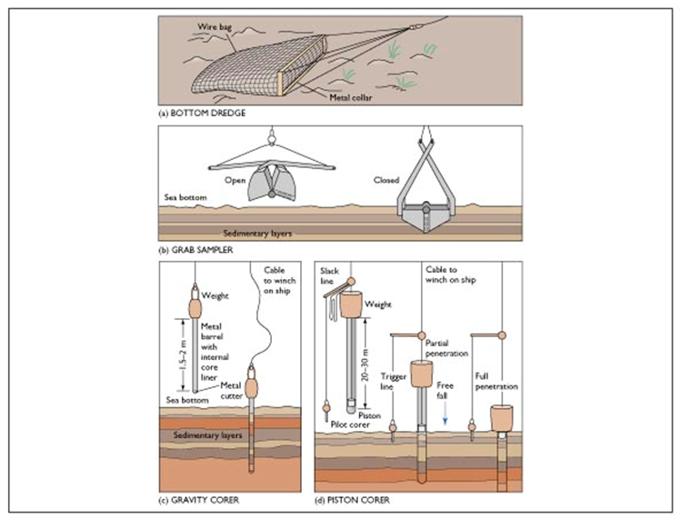

Slide 7
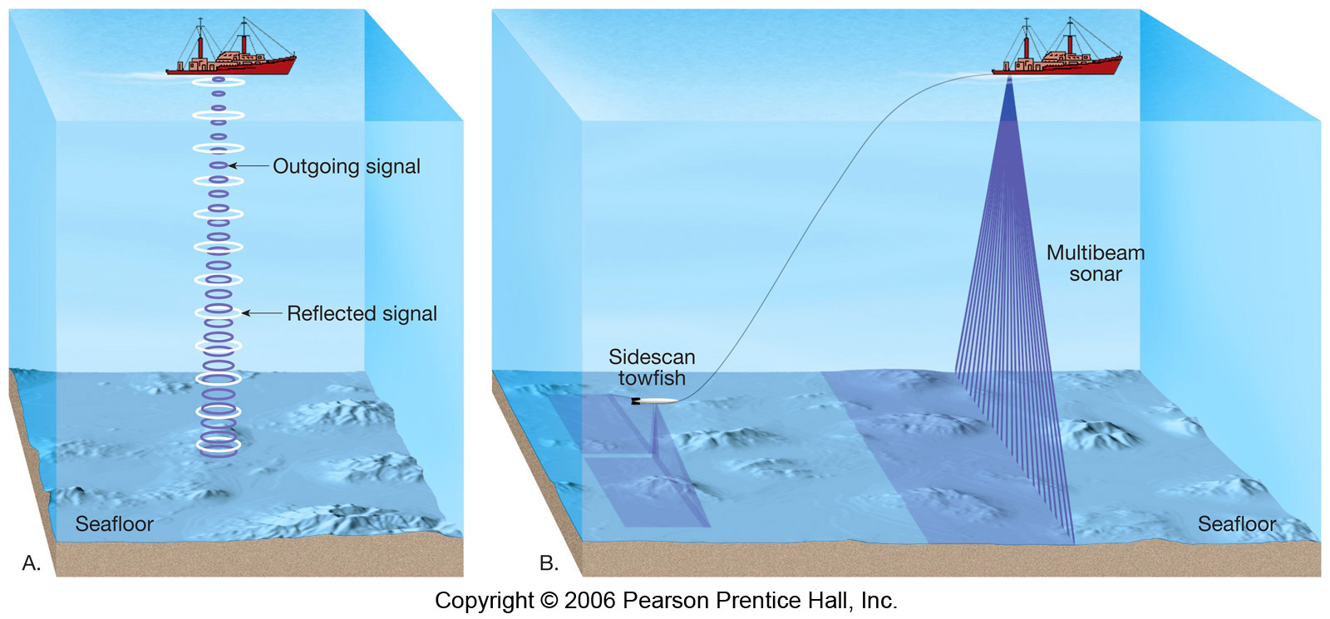
Echo sounder and
multibeam sonar

Slide 8
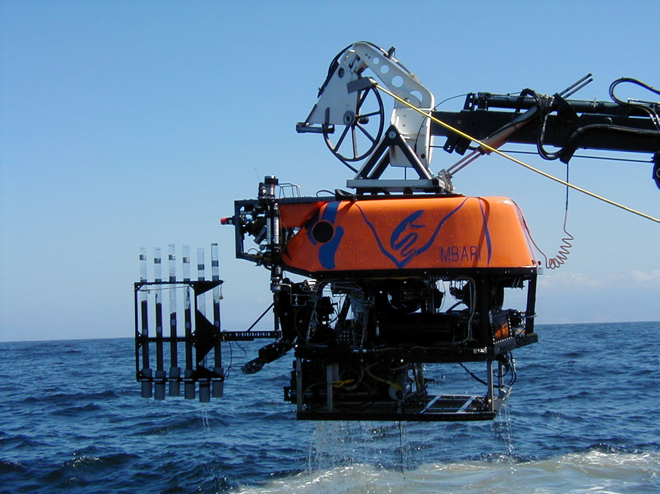

Slide 9
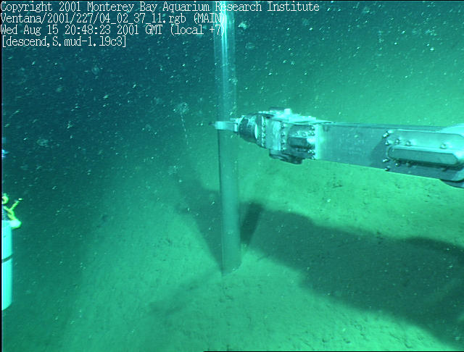

Slide 10
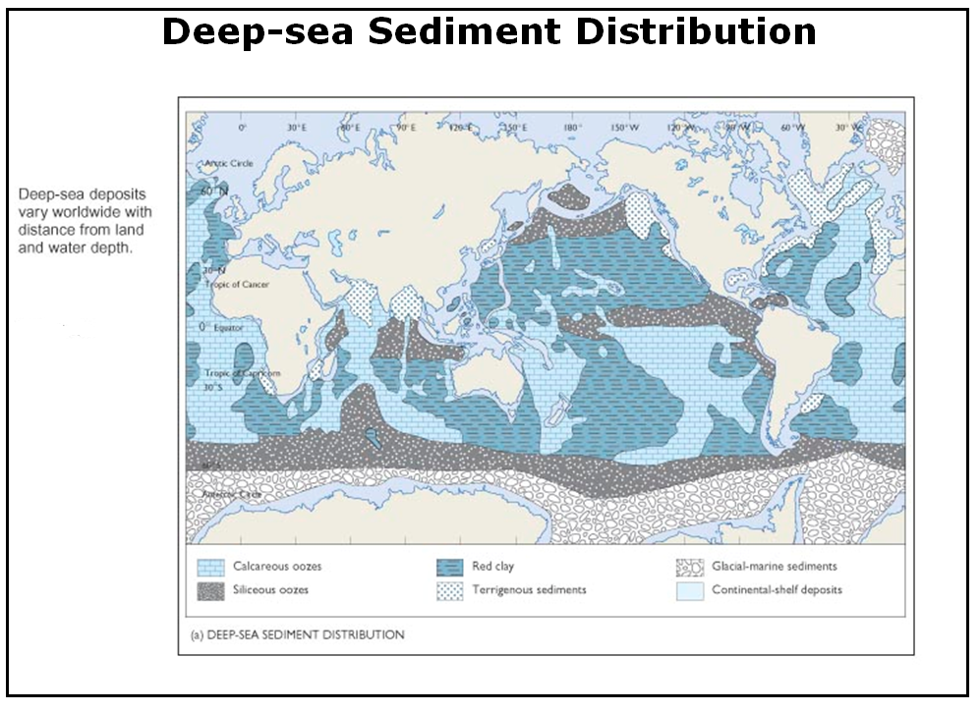

Slide 11
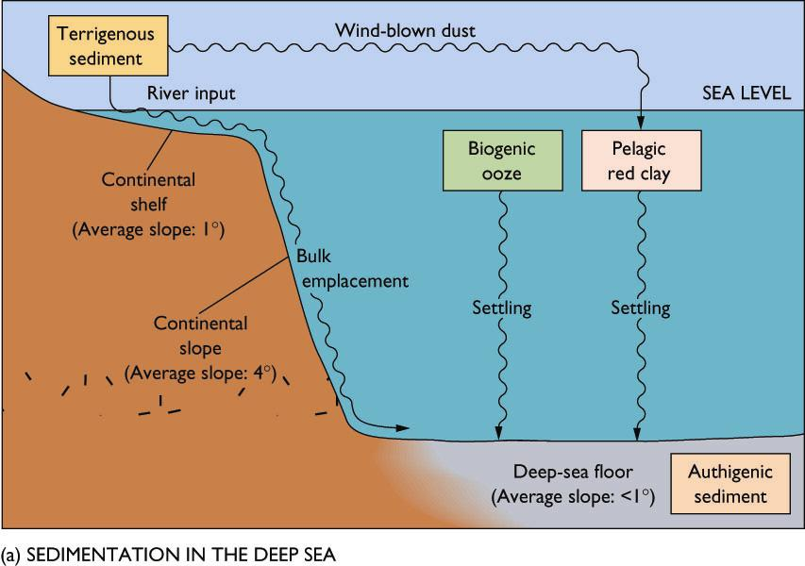
Deep-sea sedimentation processes

Slide 12
Modes of sedimentation in deep sea
Pelagic sedimentation:
  Pelagic muds:
    biogenic oozes
      >30% of debris from planktonic organisms
      Calcareous oozes (CaCO₃)
        Shells of foraminifera & pteropods (zooplankton) and coccolithophorids (phytoplankton).
        Accumulate on seafloor above CCD.
        Forms hard limestone under pressure
      Siliceous oozes (SiO₂)
        Shells of radiolaria (zooplankton) and diatoms (phytoplankton).
        Accumulate on seafloor below CCD.
        Accumulate below regions of high diatom production (equator, poles, upwelling areas)

Slide 13
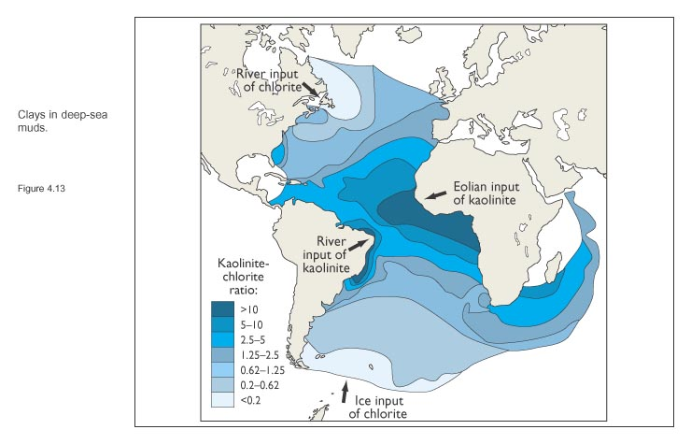
Modes of sedimentation in deep sea
Pelagic sedimentation:
  Pelagic muds:
    Inorganic red or brown clays and silt
      Fine-grained (0.0002 – 0.0004 mm)
      Quartz, feldspar, kaolinite & chlorite minerals
      Terrigenous, wind-bourne, cosmogenous source
      Kaolinite in tropical & subtropical waters
      Chlorite in temperate & subpolar
      Dominate below waters with little planktonic production.

Slide 14
Modes of sedimentation in deep sea
Bulk emplacement:
  Slumps: sediment transport by mass with little deformation or folding of layers
  Slurries: debris flows and mud flows- destroy any previous bedding or layering.
    Turbidity currents
  Deep-Sea canyons formed by these processes.
  Ice Rafting
    Polar latitudes, debris from melting icebergs.
    Glacial marine sediment

Slide 15
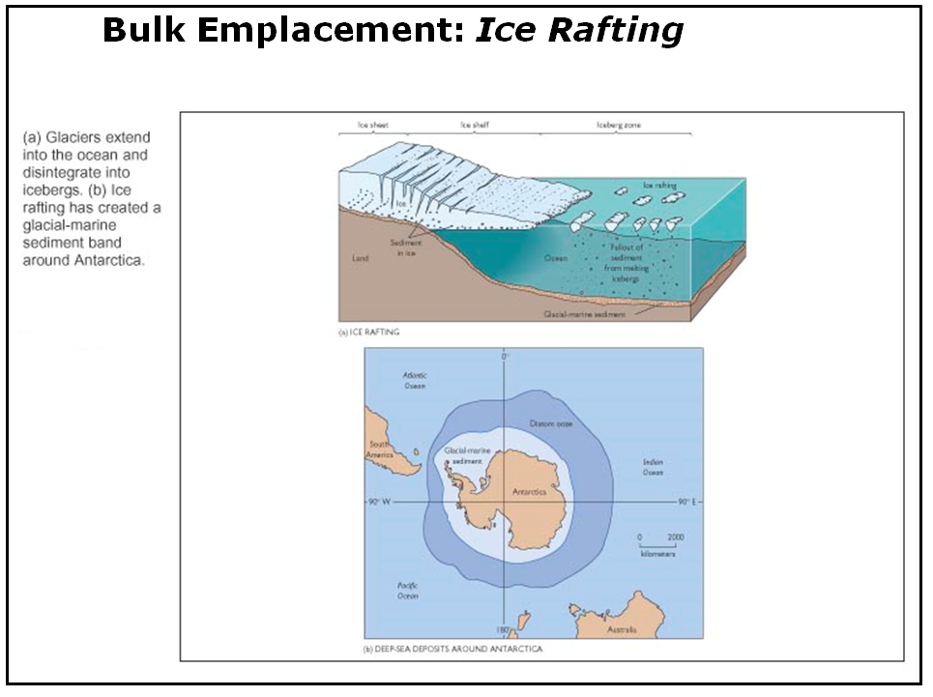

Slide 16
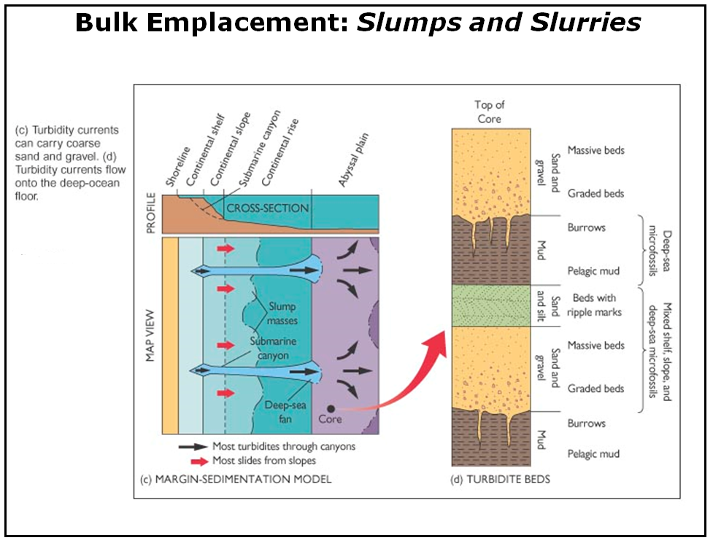

Slide 17
Classification of marine sediments based upon Mode of Formation.
Terrigenous: Sands and mud produced by weathering and erosion of rocks on land.
Biogenic: CaCO₃ (calcium carbonate) and SiO₂ (silica) muds and oozes composed of hard parts of organisms.
Authigenic: formed by precipitation of minerals in seawater (Manganese (Mn) and Phosphorus (P) nodules).
Volcanogenic: ejected from volcanoes (ash).
Cosmogenous: pieces of meteorites that survive trip thru atmosphere.

Slide 18
Worldwide distribution of recent shelf sediments by composition is strongly related to latitude and climate.
Calcareous biogenic sediments dominate tropical shelves.
River-supplied sands and muds dominate temperate shelves.
Glacial till and ice-rafted sediments dominate polar shelves.

Slide 19
Carbonate Chemistry
CaCO₃ (calcite) is a solid material produced by biological or abiological processes in seawater:
  Ca²⁺ + CO₃²⁻ CaCO₃
  The reaction can go both ways, depending on the pH, pressure.
  When the seawater is undersaturated with respect to CaCO₃, calcite will dissolve:
      Ca²⁺ + CO₃²⁻ CaCO₃
  But when seawater is saturated with respect to CaCO₃, calcite will remain in its solid form and not dissolve:

Slide 20
Deep-sea Sedimentation
The Deep sea has two main sources of sediment:
External- terrigenous material transported to oceans via rivers and wind,
internal-biogenic and authigenic from the sea.

Slide 21
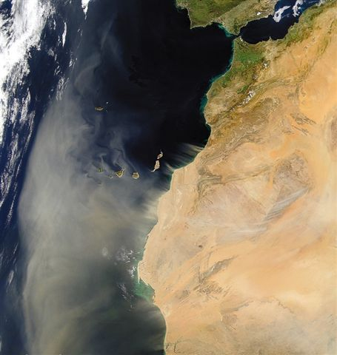
Sandstorm moving from North Africa toward Canary Island in the Atlantic Ocean

Slide 22
Authigenic deposits
Formed by chemical or biochemical reactions on ocean floor
Nodules of ferromanganese (Fe and Mn) or phosphorite (P).
Concentric layers of metal oxides accrete on particles over millions of years (1-4 mm per 10⁶ y).
Contain economically important metals Cu, Zn, Co and Pb. (but too expensive to harvest).
Origin uncertain (biological?)

Slide 23
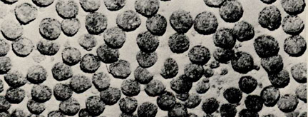
Ferromanganese nodules
Floor of South Pacific Ocean.
Nodule size 1-5 cm diameter

Slide 24
I - Continental margins
Passive continental margins
  Found along most coastal areas that surround the Atlantic Ocean
  Not associated with plate boundaries
    Experience little volcanism and
    Few earthquakes
    Wider sandy beaches

Slide 25
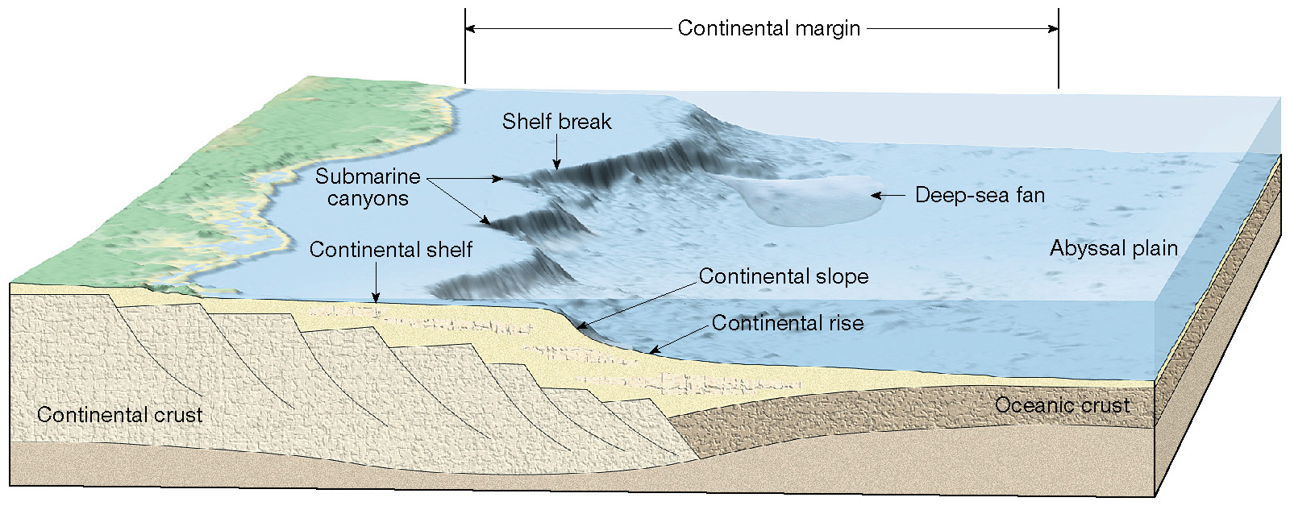
Features of a passive continental margin

Slide 26
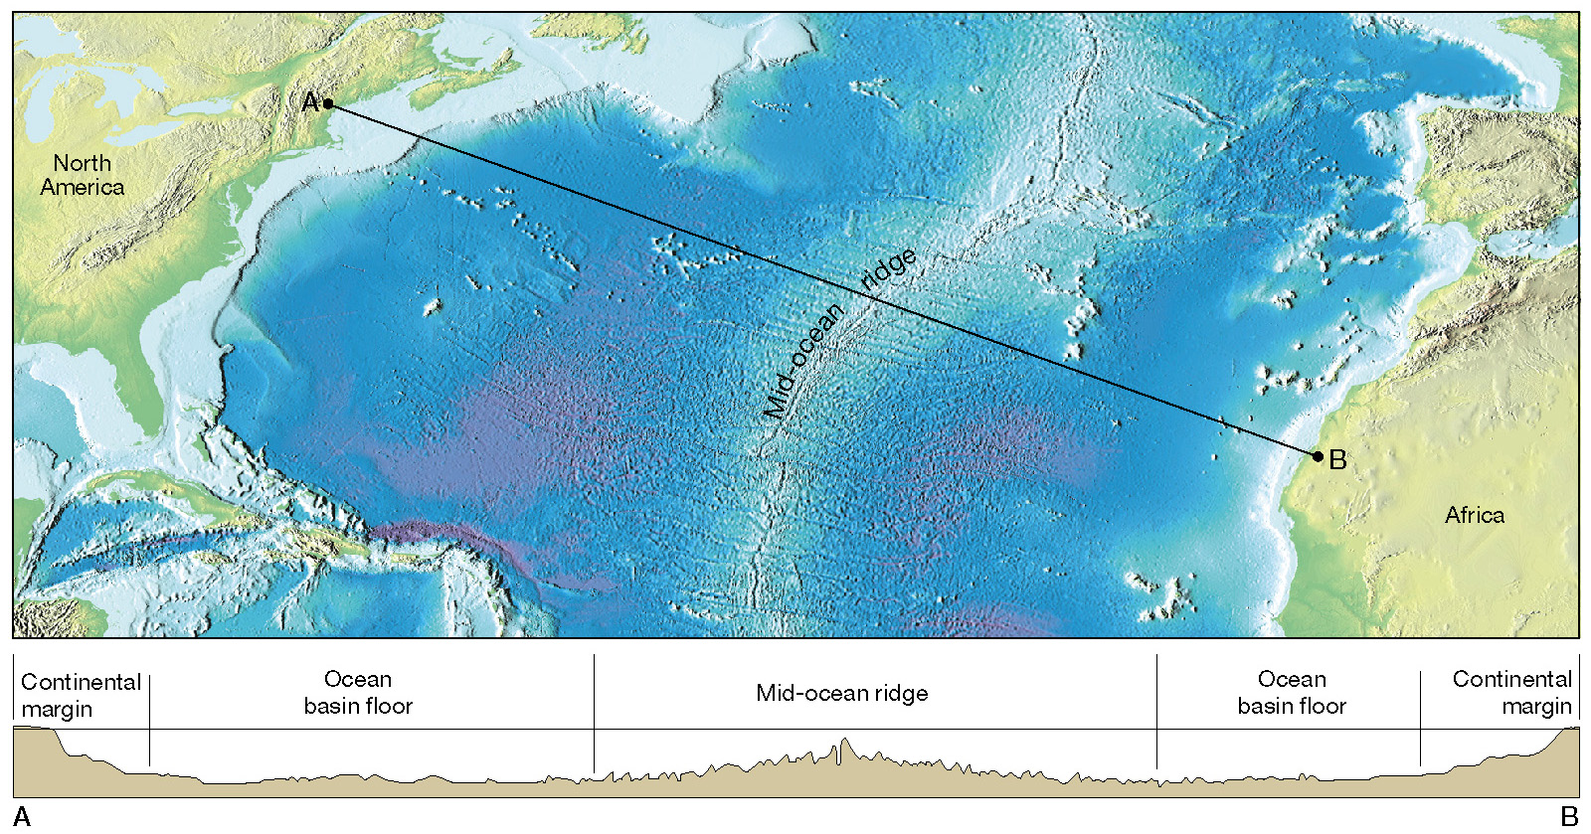
Major topographic divisions of the North Atlantic Ocean

Slide 27
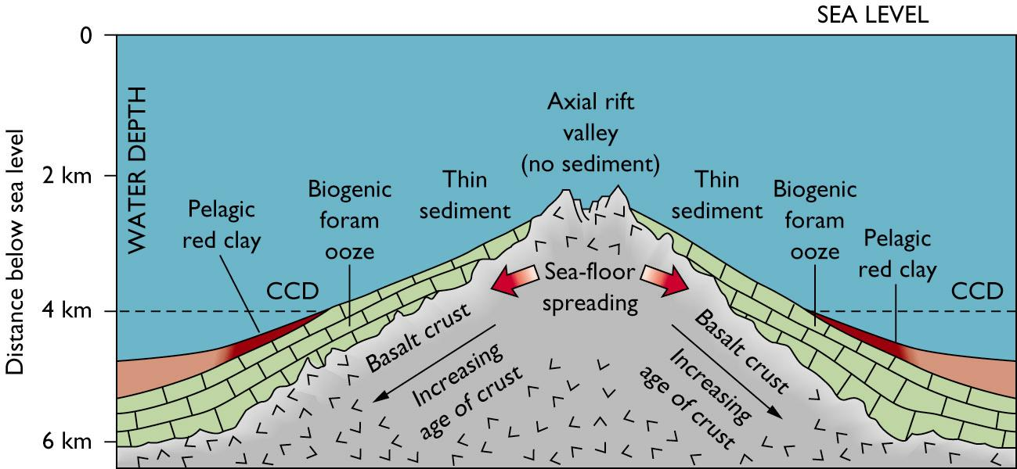
The Atlantic basin contains a “two-layer-cake” stratigraphy–a thick basal layer of carbonate ooze overlain by a layer of mud.

Slide 28
Active continental margins
  Continental slope descends abruptly into a deep-ocean trench
  Located primarily around the Pacific Ocean
  Accumulations of deformed sediment and scraps of ocean crust form accretionary wedges
  Some subduction zones have little or no accumulation of sediments (narrow beaches)

Slide 29
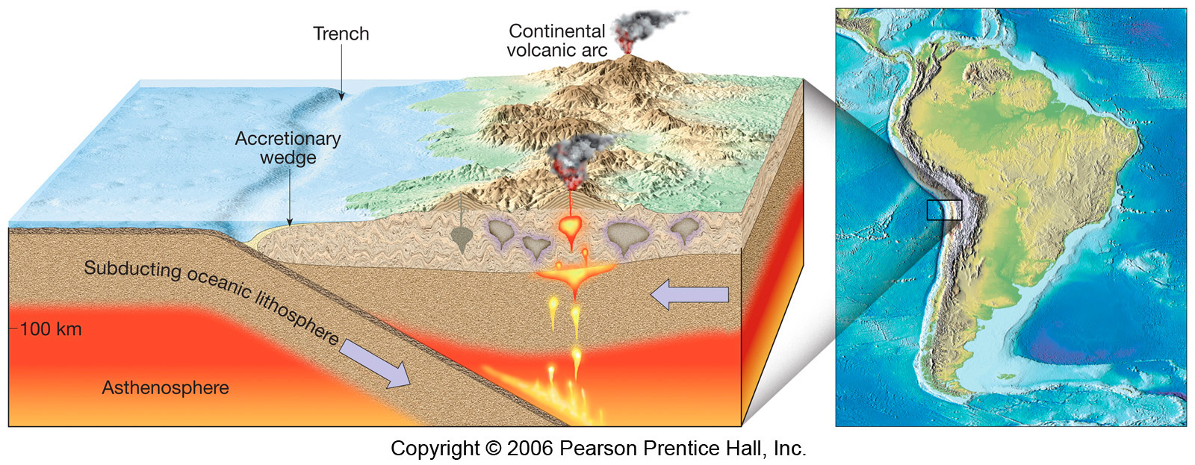
An active continental margin

Slide 30
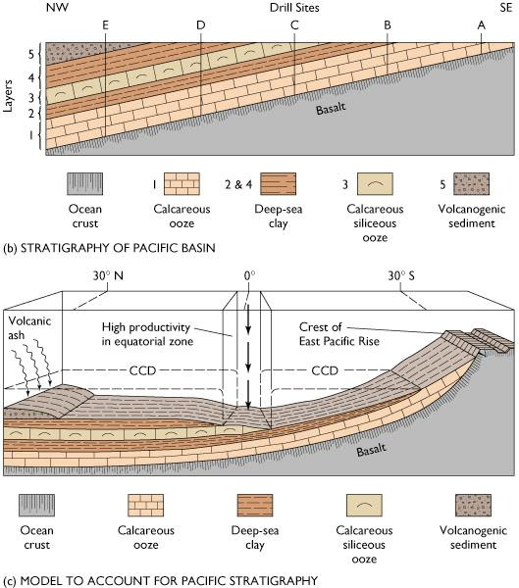
The Pacific basin contains a “five-layer-cake” stratigraphy, because unlike the Atlantic its sea floor as it spreads crosses the equator where the CCD is lowered to the ocean bottom.

